Slide 1
Power BI Adoption Framework
Empower every decision maker
Security Architecture

Slide 2


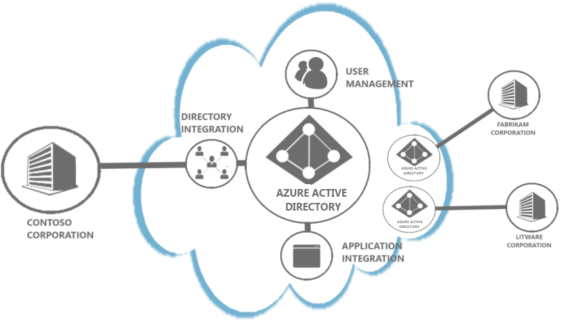
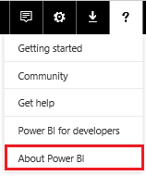

Tenants
Distinct and Separate
Users and Company
Single location

Slide 3

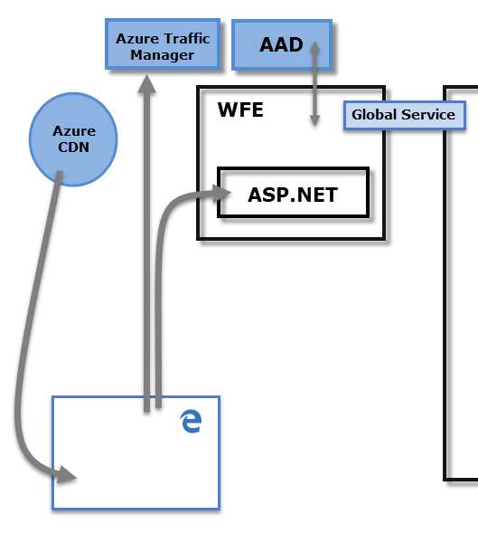


Web Front End Cluster
Azure Active Directory
Azure Traffic Manager
Azure Content Delivery Network

Slide 4

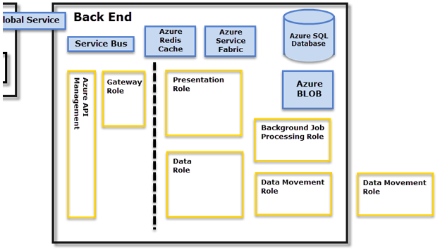
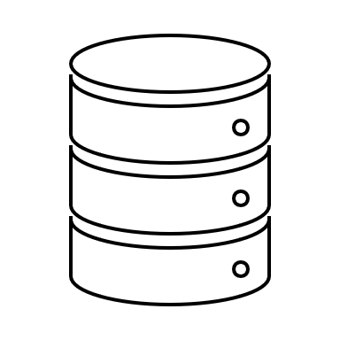

Back End Cluster
Visualisations
Data
Service Interactions

Slide 5


Data Encryption
At Rest
In Process

Slide 6

Data At Rest
Datasets
Reports
Dashboards

Slide 7


Data Encryption
Azure SQL Database
Transparent Data Encryption (TDE)
Managed by Azure SQL
Azure Blob Storage
CEK - AES_CBC_256 Key
KEK – A256KW 256-bit Key

Slide 8

Data In Process
Data Role
Analysis Services Model
Visual Caches

Slide 9
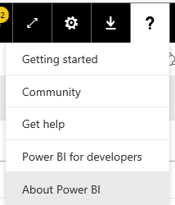
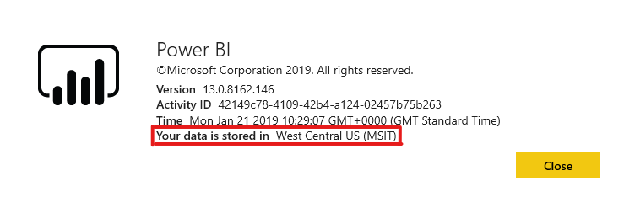
Where is my data stored?
Is my data stored in same region?
Data Sovereignty
Europe | North Europe (Ireland) West Europe (Netherlands)
Australia | Australia East (New South Wales) Australia Southeast (Victoria)
United Kingdom | UK South (London, England) UK West (Cardiff, Wales)

Slide 10


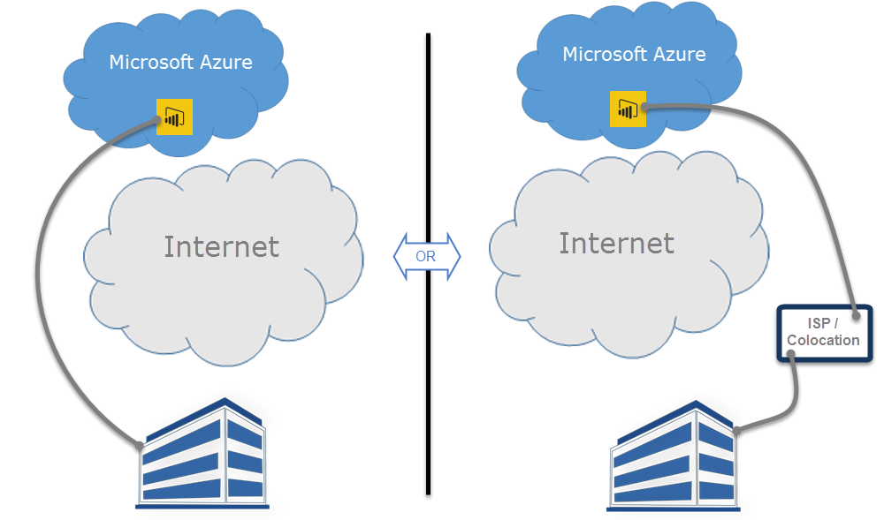

ExpressRoute
Bypass the internet
Built-In Redundancy
Predictable network performance and availability

Slide 11





ExpressRoute
Desktop / Gateway
Public Content Packs
Telemetry Data
Map Visuals
Cortana
Custom Links
Exceptions

Slide 12
Do you want to bypass the internet when connecting to Power BI?
Actions
Confirm ExpressRoute prerequisites met
Find an ExpressRoute connectivity provider
Create an ExpressRoute circuit
Create routing for ExpressRoute circuit
Link Virtual Network to ExpressRoute

Slide 13
Compliance and market availability
COMPLIANCE | AVAILABILITY
CCSL (IRAP) | √
China GB 18030 | √
CJIS | √
CSA STAR Attestation | √
CSA STAR Certification | √
DoD | √
EU Model Clauses | √
EU-U.S. Privacy Shield | √
FedRAMP | √
FERPA | √
FIPS 140-2 | √
COMPLIANCE | AVAILABILITY
FISC | √
HIPAA/HITECH | √
ISO 27001 | √
ISO 27018 | √
MeitY | √
NZ CC Framework | √
PCI DSS | √
SOC 1 | √
SOC 2 | √
SOC 3 | √
UK G-Cloud | √
REGIONS DATA LOCATIONS | AVAILABILITY
Asia Pacific | √
Australia | √
Brazil | √
Canada | √
Europe | √
India | √
Japan | √
United Kingdom | √
United States | √
NATIONAL CLOUDS | AVAILABILITY
US Government | √
China | √
Germany | √
All dates are subject to change;
https://www.microsoft.com/en-us/trustcenter/compliance/complianceofferings?product=PowerBI
Audit schedules are hard to predict and can be outside Microsoft’s control. Some certifications have an annual audit window and failure to pass the audit could result in a 1 year delay.

Slide 14
ExpressRoute
Notes:
Action: Partner to link to their or another partner offering around how to purchase, implement and maintain ExpressRoute with the customer.
Information:
ExpressRoute is an Azure service that lets you create private connections between Azure datacenters (where Power BI resides) and your on-premises infrastructure, or create private connections between Azure datacenters and your colocation environment.
With Power BI and ExpressRoute, you can create a private network connection from your organization to Power BI (or using an ISP’s colocation facility), bypassing the Internet to better secure your sensitive Power BI data and connections.
Overview - https://docs.microsoft.com/en-us/power-bi/service-admin-power-bi-expressroute
Prerequisites - https://docs.microsoft.com/en-us/azure/expressroute/expressroute-prerequisites
Connectivity Provider - https://docs.microsoft.com/en-us/azure/expressroute/expressroute-locations
Create circuit - https://docs.microsoft.com/en-us/azure/expressroute/expressroute-howto-circuit-arm
Routing - https://docs.microsoft.com/en-us/azure/expressroute/expressroute-howto-routing-arm
Linking - https://docs.microsoft.com/en-us/azure/expressroute/expressroute-howto-linkvnet-arm

Slide 15
Thank you

